Slide 1
Lecture 1-2 Classes and Objects in Java
Department of Computer Science
Hofstra University

Slide 2
Lecture Goals
Write classes, create objects, and call methods on them.
Describe what member variables, methods and constructors are.
Describe what the keywords public and private mean and their effect on where variables can be accessed
Explain what getters and setters are and write them in your classes
Explain how to overload methods in Java and why overloading methods is useful
Draw memory models with variable scope for reasoning about variable values for object type data.

Slide 3
Reasons to Choose Java
Promise of portability
write-once/run-anywhere
Efficient memory management
garbage collection
Powerful object-oriented programming
Inheritance and Polymorphism

Slide 4






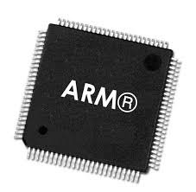


Write Once and Run Anywhere
2. Run in JVM - java HelloWorld
1. Write source code - HelloWorld.java
public class HelloWorld {
public static void main(String[] args) {
System.out.println("Hello World");
}
}
Java Virtual Machine
Java API
Native Machine Code
2. Compile source code - javac HelloWorld.java
Compiler
Operating Systems
Java Bytecode
Hardware
Obtain bytecode - HelloWorld.class

Slide 5
Java is a Platform
HelloWorld.java
Java Development Kit (JDK)
Compiler
HelloWorld.class
Other development tools
Java Runtime Environment (JRE)
Libraries and Compiled Class files
Java Virtual Machine (JVM)
Class Loader
Run Time Data Areas
Heap
Stack
Execution Engine
Execution Engine
Per instruction on the fly
Java Interpreter
Method Area
Block of source code pre-compiled
PC Register
Just-In-Time Compiler
Native Method Stack
Garbage Collector
Native Method Library
Native Method Interface

Slide 6
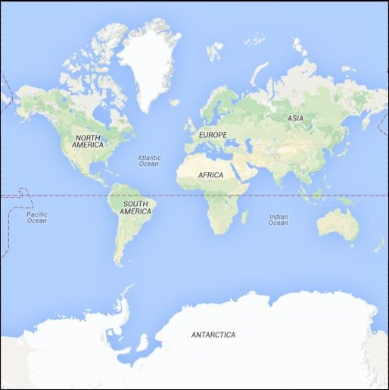
Object Oriented Programming (OOP)
Computer science -- is the science of using and processing large amounts of information to automate useful tasks and learn about the world around us using a computer.
OOP -- organizes the information based on real-world objects such that program can be:
easy to match the problem
easy to write
easy to maintain
easy to debug
Visualizing geospatial data
Map
Location
Shape
Color
......

Slide 7


Definitions of Class and Object
A class is a type of data
a template defined by the programmer
like a factory and can produce pieces of data with the template
An object is one such piece of data
made out of the factory
with associated functionality
A class can be used to produce multiple objects
Each individual object can be customized and changed without affecting others

Slide 8
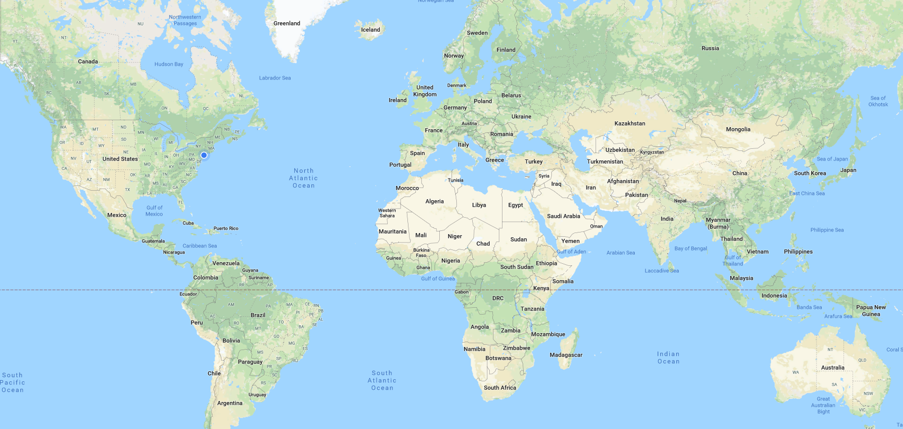
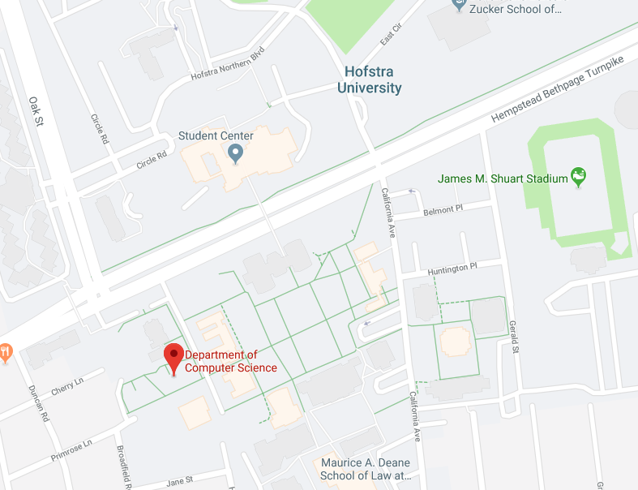
An Example of Class and Object
Concept of location Latitude: 40.7 Longitude: -73.6
I want to build a class that can represent my location in the world, or can represent anyone's location in the world.

Slide 9
Defining a Class
Must be in file Location.java
public class Location
{
public double latitude;
public double longitude;
public Location(double lat, double lon)
{
this.latitude = lat;
this.longitude = lon;
}
public double distance(Location other) {
// body not shown
}
}
Member variables:
data the objects need to store
Constructor:
Method to create a new object
Methods:
The things this class can do

Slide 10
Creating and Using Objects
In file LocationTester.java
public class LocationTester
{
public static void main(String[] args)
{
Location hof = new Location(40.7, -73.6);
Location oxford = new Location(51.7, -1.2);
System.out.println(hof.distance(oxford));
}
}
public class Location
{
public double latitude;
public double longitude;
public Location(double lat, double lon)
{
this.latitude = lat;
this.longitude = lon;
}
public double distance(Location other) {
// body not shown
}
}
In file
Location.java
"this" is the calling object

Slide 11
Creating and Using Objects (Contd.)
In file LocationTester.java
public class LocationTester
{
public static void main(String[] args)
{
Location hof = new Location(40.7, -73.6);
Location oxford = new Location(51.7, -1.2);
System.out.println(hof.distance(oxford));
}
}
$ javac *.java
$ java LocationTester
3397.26
public class Location
{
public double latitude;
public double longitude;
public Location(double lat, double lon)
{
this.latitude = lat;
this.longitude = lon;
}
public double distance(Location other) {
return getDist(this.latitude, this.longitude, other.latitude, other.longitude);
}
}
In file
Location.java
"this" is the calling object hof

Slide 12
The Main Method in Java
Java begins execution with the first line of a "main" method
This method can be defined in any class, usually public.
When a class has a main method, it can be "run”, and usually there is only one class with main method in a Java program
The keyword static, when applied to a method or a member variable, simply means that this method (or member variable) is defined for the class, but not for particular objects in the class. Thus, main is a general method.
There is no "calling object" inside main. If you want to call instance methods from main, you must create objects and then call the instance methods on those objects. You can, however, call other static methods directly.
public static void main(String[] args)
public class Location
{
public double latitude;
public double longitude;
public Location(double lat, double lon)
{
this.latitude = lat;
this.longitude = lon;
}
public double distance(Location other) {
return getDist(this.latitude, this.longitude, other.latitude, other.longitude);
}
public static void main(String[] args) {
Location hof = new Location(40.7, -73.6);
Location oxford = new Location(51.7, -1.2);
this.distance(hof);
hof.distance(oxford);
}
}
✖
✔

Slide 13
Overloading Methods
public class Location
{
public double latitude;
public double longitude;
public Location(double lat, double lon)
{
this.latitude = lat;
this.longitude = lon;
}
public double distance(Location other) {
// body not shown
}
}
In file Location.java
What if the user wants to create Location objects without passing in any parameters?

Slide 14
Overloading Methods (Contd.)
public class Location
{
public double latitude;
public double longitude;
public Location() {
this.latitude = 40.7;
this.longitude = -73.6;
}
public Location(double lat, double lon) {
this.latitude = lat;
this.longitude = lon;
}
public double distance(Location other) {
// body not shown
}
}
In file Location.java
Constructor without parameters
Default constructor
Overloading
Parameter constructor

Slide 15
Overloading Methods (Contd.)
public class Location
{
// Code omitted here
public double distance(Location other)
{
// body not shown
}
public double distance(double otherLat, double otherLon) {
// body not shown
}
}
In file Location.java
What is the advantage? We don’t have to create and remember different names for functions doing the same thing. For example, in our code, if overloading was not supported by Java, we would have to create method names like distance1 and distance2.

Slide 16
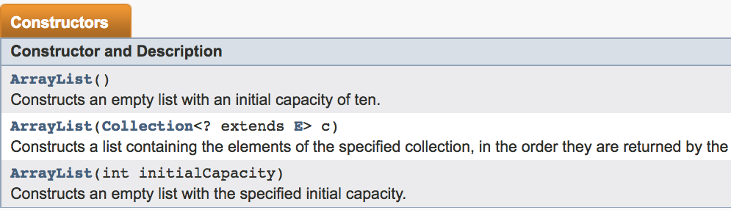
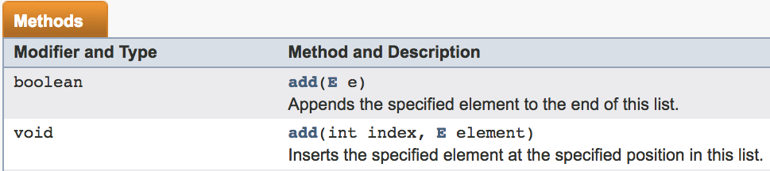
A Real-world Example of Overloading
ArrayList in Java API: overloaded constructors and add method

Slide 17
CAUTION
public class Location
{
// Code omitted here
public double distance(Location other)
{
// body not shown
}
public int distance(Location other)
{
// body not shown
}
}
In file Location.java
Parameter must be different
At compile time, the compiler decides which version of the overloaded method you're actually trying to call by using the parameter list. It can't do that by using the return type alone.

Slide 18
Public vs. Private: Protect Data and Method
public class Location
{
public double latitude;
public double longitude;
public Location(double lat, double lon) {
this.latitude = lat;
this.longitude = lon;
}
public double distance(Location other) {
// body not shown
}
}
In file Location.java
public means can access from any class
public class LocationTester
{
public static void main(String[] args)
{
Location hof = new Location(40.7, -73.6);
Location oxford = new Location(51.7, -1.2);
hof.latitude = 35.2;
System.out.println(hof.distance(oxford));
}
}
In file LocationTester.java
allowed

Slide 19
Public vs. Private: Protect Data and Method
public class Location
{
private double latitude;
private double longitude;
public Location(double lat, double lon) {
this.latitude = lat;
this.longitude = lon;
}
public double distance(Location other) {
// body not shown
}
}
In file Location.java
private means can access only from Location
allowed
public class LocationTester
{
public static void main(String[] args)
{
Location hof = new Location(40.7, -73.6);
Location oxford = new Location(51.7, -1.2);
hof.latitude = 35.2;
System.out.println(hof.distance(oxford));
}
}
In file LocationTester.java
ERROR

Slide 20
Basic Class Design Rules
Rule of thumb: Make member variables private (and methods either public or private)
Methods
Members
Private: helper methods
Private: use getters and setters
Public: for world use
giving right level of access

Slide 21
An Example of Getter
In file Location.java
public class Location
{
private double latitude;
private double longitude;
// code omitted here
public double getLatitude()
{
return this.latitude;
}
}
Can the user change the value ?
getter
public class LocationTester
{
public static void main(String[] args)
{
Location hof = new Location(40.7, -73.6);
System.out.println(hof.latitude);
System.out.println(hof.getLatitude());
}
}
In file LocationTester.java
ERROR
allowed

Slide 22
An Example of Setter
In file Location.java
public class Location
{
private double latitude;
private double longitude;
// code omitted here
public void setLatitude(double lat)
{
this.latitude = lat;
}
}
why don’t we just make that member variable public? If we're exposing the ability to change and read it?
setter
public class LocationTester
{
public static void main(String[] args)
{
Location hof = new Location(40.7, -73.6);
hof.latitude = 35.2;
hof.setLatitude(35.2);
}
}
In file LocationTester.java
ERROR
allowed

Slide 23
Another Example of Setter
public void setLatitude(double lat)
{
if (lat < -180 || lat > 180)
{
System.out.println("Illegal value for latitude");
} else {
this.latitude = lat;
}
}
getters and setters give us more control

Slide 24
Trace Your Code: Drawing Memory Model
what does this code print?
int var1;
var1 = 52;
int var2;
var2 = var1;
var1 = 127;
System.out.println("var1 is " + var1 +
", var2 is " + var2);
Variable declaration: draw a box and label it with the variable's name
Variable assignment: put the value of the right hand side into the box for the variable on the left hand side
NOT connected and just copy the value
52
52
var1
127
var2
$ var1 is 127, var2 is 52
Primitive type data: int,double, float, short, long, char, boolean, byte

Slide 25
Drawing Memory Model with Objects
In file Location.java
public class Location
{ private double latitude;
// Code omitted here
public static void main(String[] args)
{
int var1 = 52;
Location hof;
hof = new Location(40.7, -73.6);
Location oxford = new Location(51.7 , -1.2);
hof.latitude = 35.2;
variable declaration and same as primitives
memory reference
assignment statement
// in main method and can access private var
Java Heap
var1
52
Location Object
Latitude
35.2
40.7
@20
reference
hof
@20
Longitude
-73.6
Location Object
oxford
@30
Latitude
51.7
@30
reference
Longitude
-1.2

Slide 26
More Examples
public class Location
{
// Code omitted here
public static void main(String[] args)
{
Location loc1 = new Location(40.7, -73.6);
Location loc2 = new Location(51.7 , -1.2);
loc1 = loc2;
loc1.latitude = 35.2;
System.out.println(loc2.latitute + ”, " + loc2.longitude);
After assignment loc1 = loc2, the Object Location(40.7, -73.6) is unreachable and should be garbage-collected.
Location Object
Latitude
40.7
@1
@1
loc1
@2
Longitude
-73.6
$ 35.2, -1.2
Location Object
loc2
@2
Latitude
35.2
51.7
@2
Longitude
-1.2

Slide 27
Reason Your Code with Scope
In file Location.java
public class Location
{
private double latitude;
private double longitude;
public Location(double lat, double lon) {
this.latitude = lat;
this.longitude = lon;
}
}
Member variables are declared outside any method
Parameters behave like local variables
public class LocationTester
{
public static void main(String[] args)
{
Location hof = new Location(40.7, -73.6);
hof.latitude = 2.5;
}
}
In file LocationTester.java
Local variables are declared inside a method
ERROR. Variable not defined here
The scope of a variable is the area where it is defined to have a value

Slide 28
An Example
In file
Location.java
In file
LocationTester.java
public class Location
{
public double latitude;
public double longitude;
public Location(double latIn, double lonIn) {
this.latitude = latIn;
this.longitude = lonIn;
}
}
public class LocationTester
{
public static void main(String[] args)
{
double lat = 40.7;
Location hof = new Location(lat, -73.6);
}
}
Java Heap
lat
40.7
latIn
40.7
40.7
Location Object
hof
lonIn
-73.6
@1
-73.6
Latitude
@1
main's scope
this
Longitude
constructor's scope

Slide 29
An Example (Contd.)
In file
Location.java
In file
LocationTester.java
public class Location
{
public double latitude;
public double longitude;
public Location(double latIn, double lonIn) {
this.latitude = latIn;
this.longitude = lonIn;
}
}
public class LocationTester
{
public static void main(String[] args)
{
double lat = 40.7;
Location hof = new Location(lat, -73.6);
}
}
Looks for latitude in the constructor‘s local scope
this is optional
Doesn't find it, so looks in calling object scope
Java Heap
lat
latIn
40.7
40.7
40.7
Location Object
-73.6
hof
lonIn
-73.6
Latitude
@1
main's scope
this
Longitude
constructor's scope

Slide 30
Another Example
public class ArrayLocation
{
private double coords[];
public ArrayLocation(double[] coords) {
this.coords = coords;
}
public static void main(String[] args)
{
double[] coords = {5.0, 0.0};
ArrayLocation hof = new ArrayLocation(coords);
coords[0] = 40.7;
coords[1] = -73.6;
System.out.println(hof.coords[0]);
}
}
In file
ArrayLocation.java
$ 40.7
Java Heap
coords
main's scope
5.0
0.0
40.7
-73.6
hof
ArrayLocation Object
constructor's scope
coords
this
coords

